Slide 1
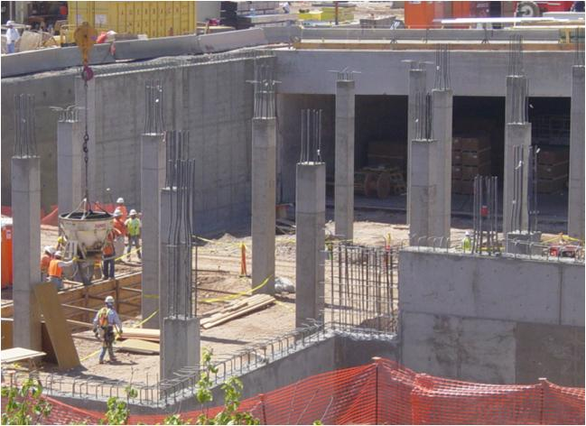
Section 1
Concrete Mix Design
1

Slide 2
CONCRETE INGREDIENTS
Aggregates
Fine
Coarse
Portland Cement (PC)
Water
Admixtures
Paste = PC + Water
Mortar = PC + Water + Fine aggregate
Concrete = PC + Water + Coarse and Fine aggregates
2
Notes:
PCC consists of aggregate (coarse and fine), PC and water. The paste consists of PC and water, while the mortar consists of PC, water and sand.

Slide 3
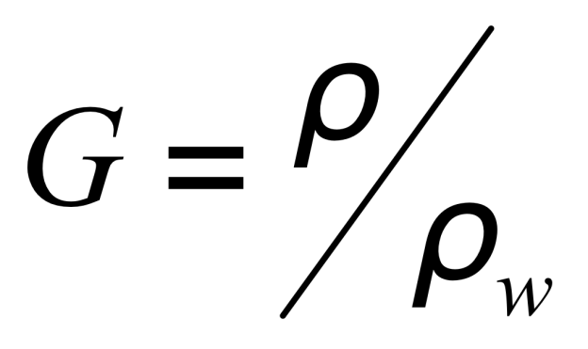
DENSITY AND UNIT WEIGHT
density = ρ = m / V
unit weight = γ = W / V
specific gravity
3

Slide 4
WATER CONTENT
Oven Dry Air Dry SSD Moist
4

Slide 5
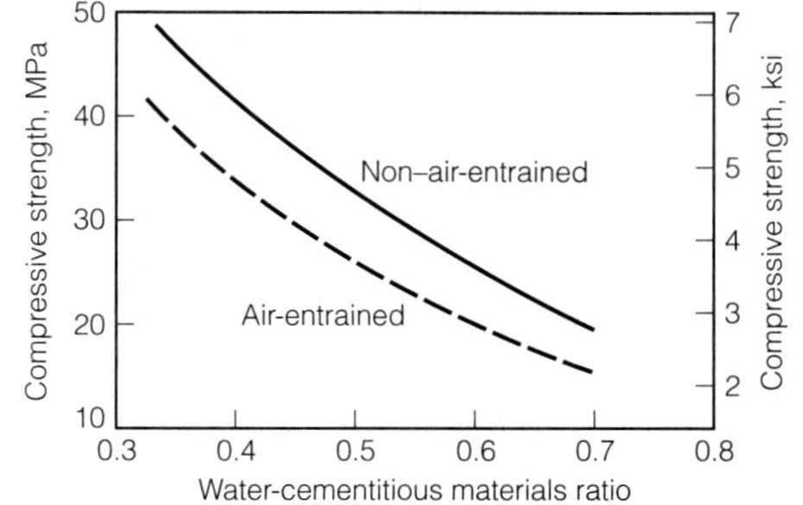
WATER-CEMENT RATIO
historical records of strength are used to plot f’_{c} vs. w/c
f’_{cr}
w/c Ratio
5
5

Slide 6
MOISTURE ADJUSTMENTS EXAMPLE
The following preliminary concrete mix has been designed assuming that the aggregates are in oven-dry condition.
Water 305 lb/yd³
Cement 693 lb/yd³
Coarse aggregate (SSD) 1,674 lb/yd³
Fine aggregate (SSD) 1,100 Ib/yd³
The properties of the aggregates are: CA FA
Absorption (moisture content at SSD) 0.5% 0.7%
Moisture content as used in mix 2.0% 6.0%
The amount of water (lb/yd³) that would be used in the final mix is most nearly:
(A) 206
(B) 222
(C) 305
(D) 388
6

Slide 7
MOISTURE ADJUSTMENTS EXAMPLE
The moisture content of each aggregate includes: (1) water that would be needed to bring aggregates to SSD condition (the absorbed water) and (2) the excess water that is free to add to the mix water. Since the as-used moisture content is greater than the absorption for each aggregate, each aggregate contributes the excess water to the mix, thus reducing the water that must be added to mix. The water added to the mix is the water computed for oven-dry aggregates (305 Ib/yd¹) plus the excess water in each aggregate.
Final water 305 -[(2.0% -0.5%)/100] x 1,674 -[(6.0% -0.7%)1100] x 1,100 = 221.61b/yd³
THE CORRECT ANSWER IS: (B)
7

Slide 8
OVERDESIGN
Design engineer “specifies” a strength of concrete used for design calculations – f’_{c}
Concrete strength is variable
Material engineer designs concrete so only a small proportion of the concrete will have a strength less than the strength assumed by the design engineer.
8

Slide 9
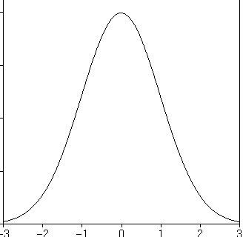
STRENGTH REQUIREMENTS
f’_{c}
f’_{cr}
Average strength
Normal distribution
f’_{cr} = f’_{c} + 1.34s
1.34s
½ the concrete has a strength less than
average
f’_{cr} – average strength for mix design
Adding 1.34s to f’_{c} – 90% of the concrete will be stronger than specified strength
Standard deviations
Increasing strength
9

Slide 10
STRENGTH REQUIREMENTS
f’_{cr} = f’_{c} + (1.34 s) when s < 500 psi
If s > 500 psi :
f’_{cr} = f’_{c} + (2.33 s) - 500 psi
s = standard deviation of f’_{c} for a particular mixing plant
If s is based on fewer than 30 samples, then the standard deviation of the “population” is underestimated
10

Slide 11
Section 2
Asphalt Mix Design
11

Slide 12
SUPERPAVE & PERFORMANCE GRADE BINDERS
After the Strategic Highway Research Program (SHRP)
Superpave (Superior Performing Asphalt Pavements)
mix design method for asphalt concrete
performance grading method for asphalt binder specification
Mamlouk/Zaniewski, Materials for Civil and Construction Engineers, Third Edition. Copyright © 2011 Pearson Education, Inc.
12

Slide 13
PERFORMANCE GRADE BINDER CHARACTERIZATION
Control specific distresses
Rutting
Fatigue cracking
Thermal cracking
Specific aging conditions
Unaged
Construction
Long term
Mamlouk/Zaniewski, Materials for Civil and Construction Engineers, Third Edition. Copyright © 2011 Pearson Education, Inc.
13

Slide 14
SUMMARY
Fatigue
Cracking
Low Temp
Cracking
Construction
Rutting
[DTT]
[RV]
[DSR]
[BBR]
RTFO
Short Term Aging
No aging
PAV
Long Term Aging
14
Notes:
This figure summarizes the testing required for the PG binder specification.

Slide 15
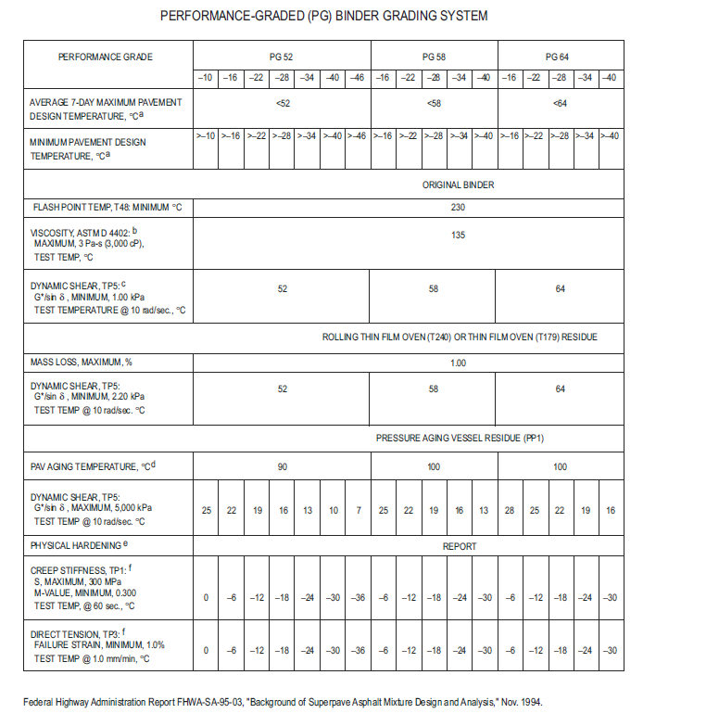
15

Slide 16
SUPERPAVE BINDER SELECTION EXAMPLE
Average 7-day Maximum Pavement Temperature = 63 ° C
Minimum Pavement Temperature = -23° C
Superpave Binder Grace PG-64-22
16

Slide 17
PROPERTIES EVALUATED FOR HMA MIX DESIGN
Percent G_{mm} at N_{initial}
Voids in total mix VTM – air voids embedded in the HMA
4% for mix design
4 to 8% for construction
>2% over the live of the pavement
Voids in the mineral aggregate VMA – measure of the asphalt film thickness – controls the minimum asphalt content
Criteria is a minimum
Decreases as the nominal maximum aggregate size increases
Large aggregates have less surface area to coat
Voids filled with asphalt VFA – percent of the VMA filled with asphalt
Criteria is a range
In mix design controls the maximum asphalt content
Dust to binder ratio D/B – controls dust in the mastic of dust & binder
Mamlouk/Zaniewski, Materials for Civil and Construction Engineers, Third Edition. Copyright © 2011 Pearson Education, Inc.
17

Slide 18
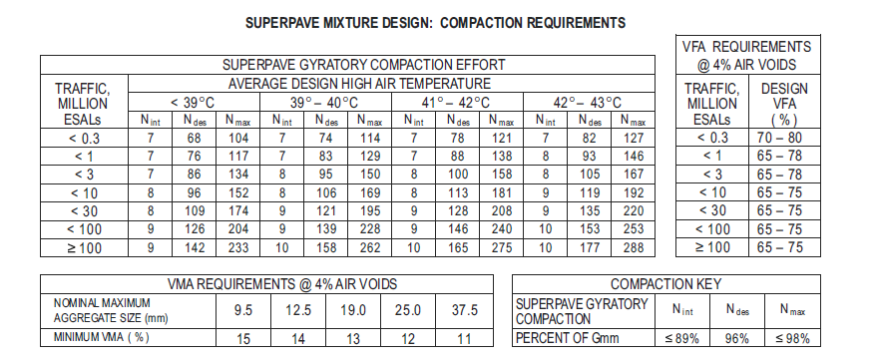
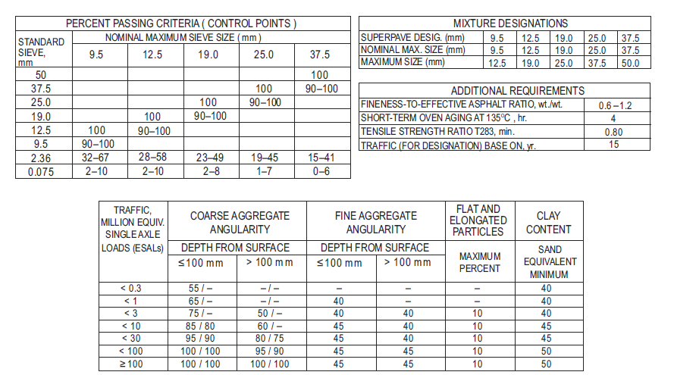
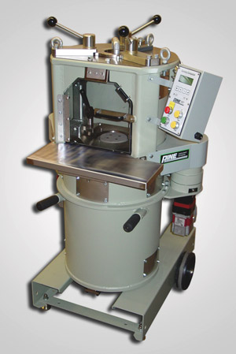
18

Slide 19
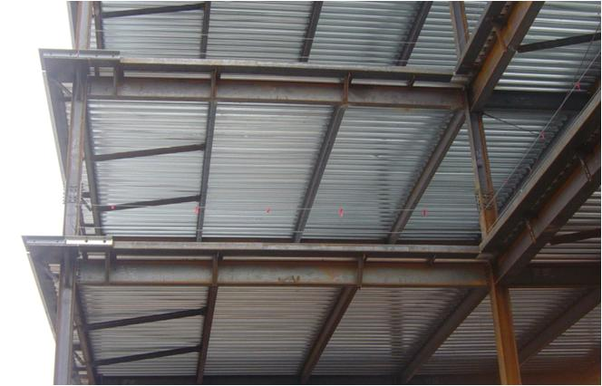
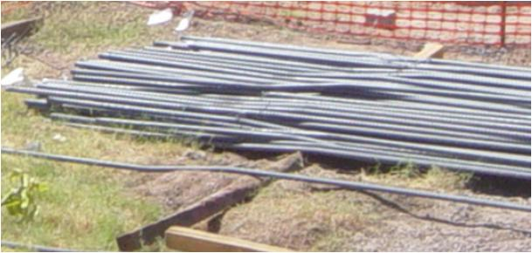
Section 3
Test Methods
19

Slide 20
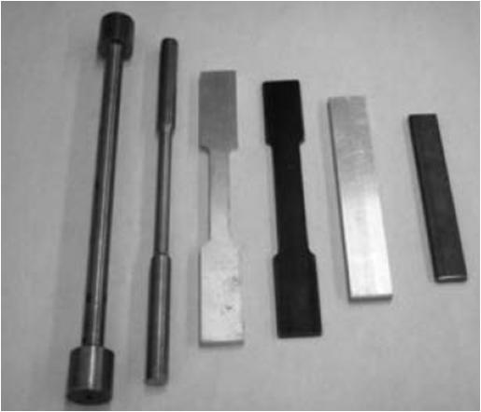
MECHANICAL TESTING OF STEEL
Tension Test
Determine yield strength, ultimate (tensile) strength, elongation, and reduction of area (Poisson's Ratio)
Plate, sheet, round rod, wire, and tube can be tested
Typical specimens are round or rectangular
20

Slide 21
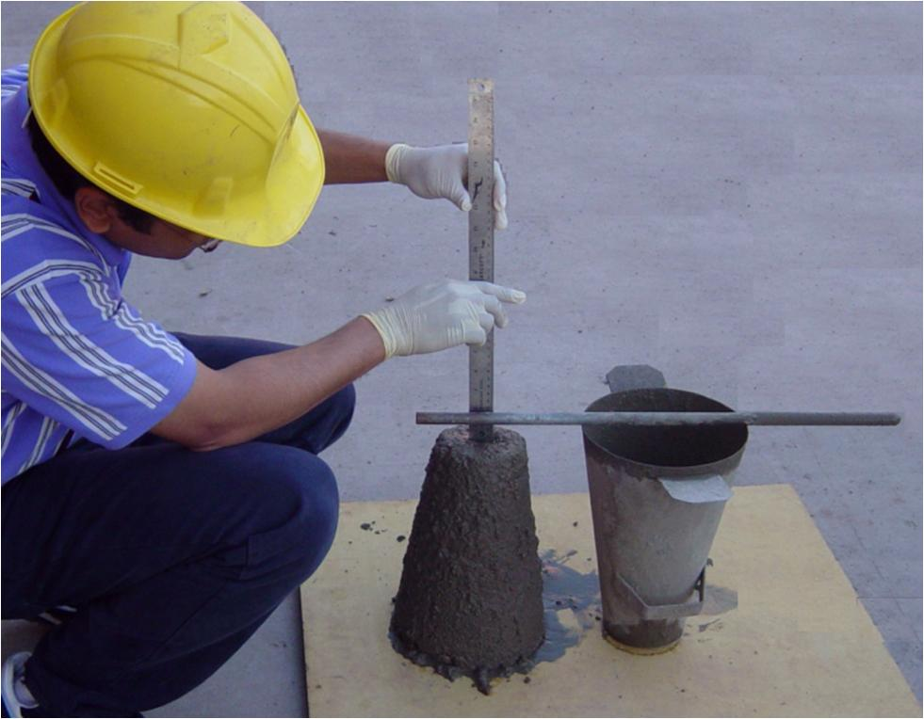
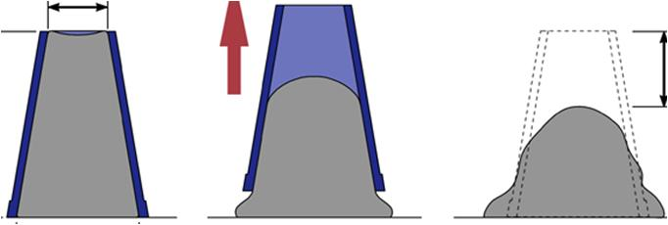
SLUMP
Workability is measured by slump test
fill a cone in 3 layers, 25 rods each layer
lift cone off and measure distance it slumps from original height
21

Slide 22
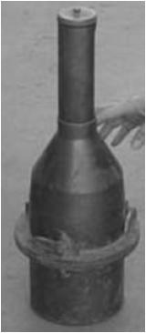
AIR CONTENT TEST FOR FRESH CONCRETE
Measures total air content (entrapped and entrained)
Only entrained is good but we can't tell the difference from this test
Pressure Method
Volumetric Method
Gravimetric Method
Chase Air Indicator
22

Slide 23
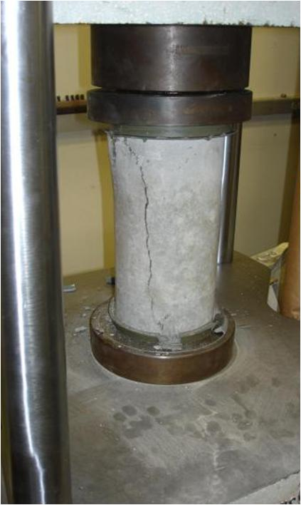
TESTING OF HARDENED CONCRETE
Compressive Strength (f’_{c}) Test
Most common test by far (even more than slump)
2:1 cylinders cast in 3 layers rodded 25 times each layer and cured at 95% humidity
Or specimens are cored from structure
7 day = 60% of 28 day and 28 day = 80% ultimate strength
Typical compressive strength is 3,000 - 6,000 psi
23

Slide 24
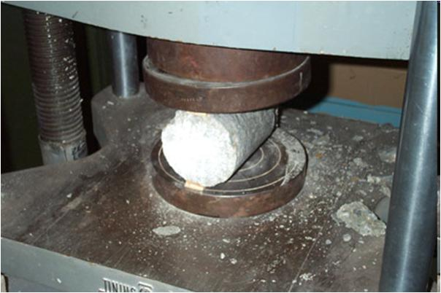
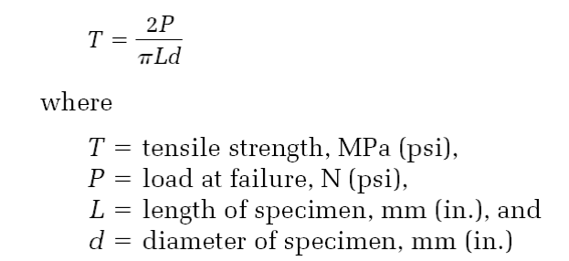
Split Tension Test
To measure tensile strength
about 10% of f'_{c}
24

Slide 25
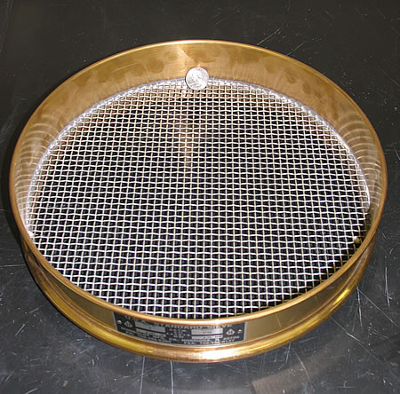
AGGREGATE SIZES
Coarse aggregate material retained on a sieve with 4.75 mm openings
Fine aggregate material passing a sieve with 4.75 mm openings
Traditional
Maximum aggregate size – the largest sieve size that allows all the aggregates to pass
Nominal maximum aggregate size – the first sieve to retain some aggregate, generally less than 10%
1”
#4 sieve = four openings/linear inch
4.75mm
25

Slide 26
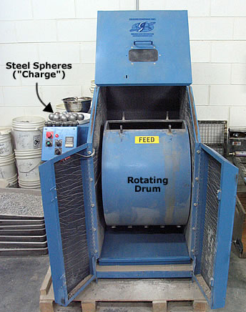
TOUGHNESS & ABRASION RESISTANCE
Resist load damage
During construction
Traffic loads
LA abrasion test
Charge drum w/ sample
Steel spheres
500 revolutions
Sieve
Prepare sample
Minimum mass original
Specified gradation
26
26

Slide 27
Section 4
Properties of Aggregates
27

Slide 28
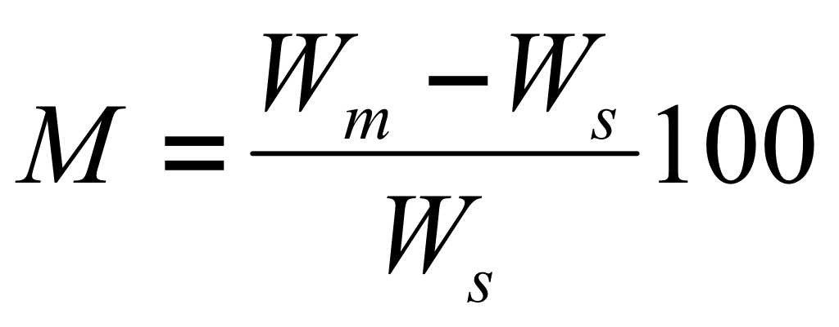
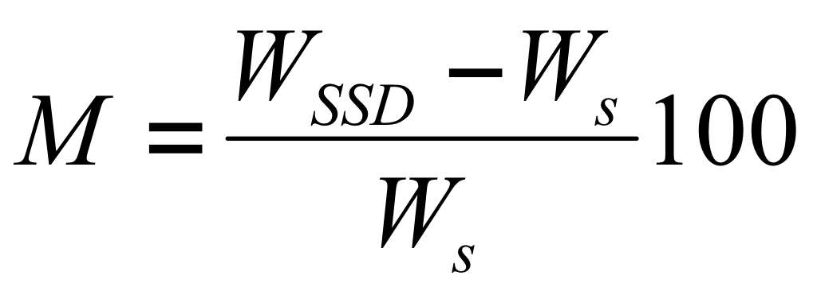
Aggregate Moisture States
Internal impervious voids
Voids partially filled
Free moisture
Bone dry – dried in oven to constant mass
Air dry – moisture condition state undefined
Saturated surface dry – moisture condition state undefined
Moist – moisture condition state undefined
W_{s}
W_{m}
W_{SSD}=W_{s}+W_{p}
W_{m}
Moisture content
Absorption
Moisture content
A
Absorption is the moisture content when the aggregates are in the SSD condition
Free moisture is the moisture content in excess of the SSD condition.
Percent free moisture = M - A
Important for proportioning concrete negative free moisture – aggregates will absorb water
positive free moisture – aggregates will release water
28

Slide 29
SPECIFIC GRAVITY
The mass of a material divided by the mass of water whose volume is equal to the volume of the material at a specific temperature, or
G = ρ / ρ_{w}
ρ_{w} = density of water at specified temperature
@ 4°C, ρ_{w} is:
1000 kg/m³ = 1 g/ml = 1 g/cc
62.4 lb/ft³ (remember to stay consistent with force and mass units for measurements and the issue of force and mass will go away as G is a ratio)
Mass Solid
Volume
G =
Mass Water
Volume
29

Slide 30
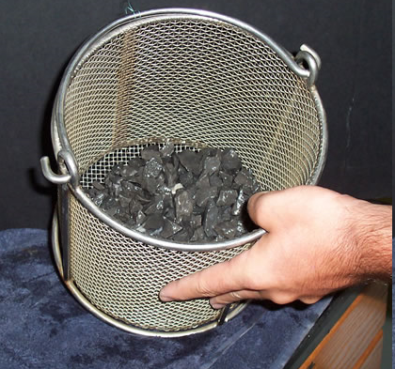
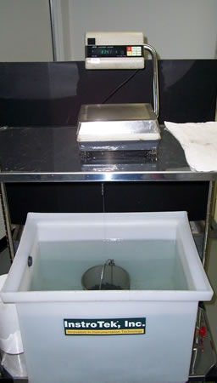
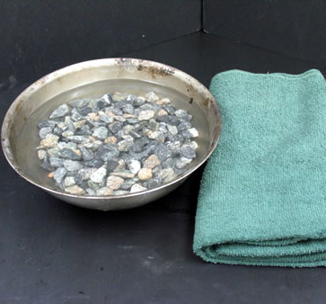
Coarse Aggregate Specific Gravity by the Book
(ASTM C127)
Dry then saturate the aggregates
Dry to SSD condition and weigh
Measure submerged weight
Measure dry weight
30

Slide 31
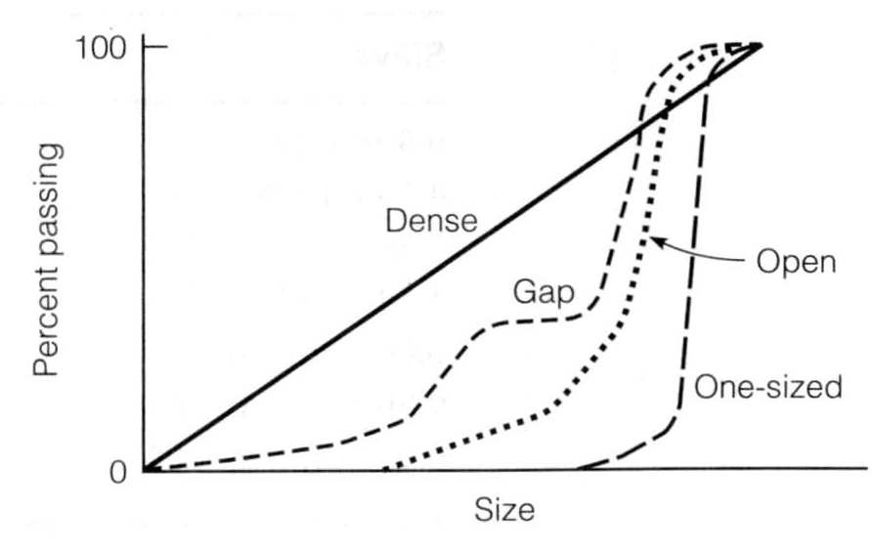
Types of Gradation on 0.45 Power Graph
31

Slide 32
Section 5
Engineering Properties of Metals
32

Slide 33
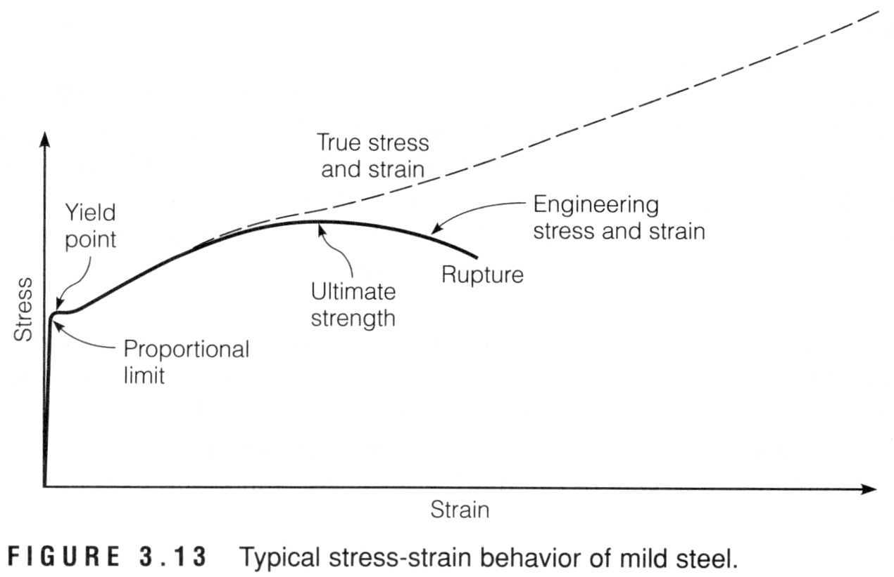
Typical Stress-Strain Behavior of Mild Steel
σ-ε is linear elastic up to proportional limit.
Then non-linear elastic up to elastic limit = yield point = strain increases at constant stress.
Then plastic deformation until failure.
33

Slide 34
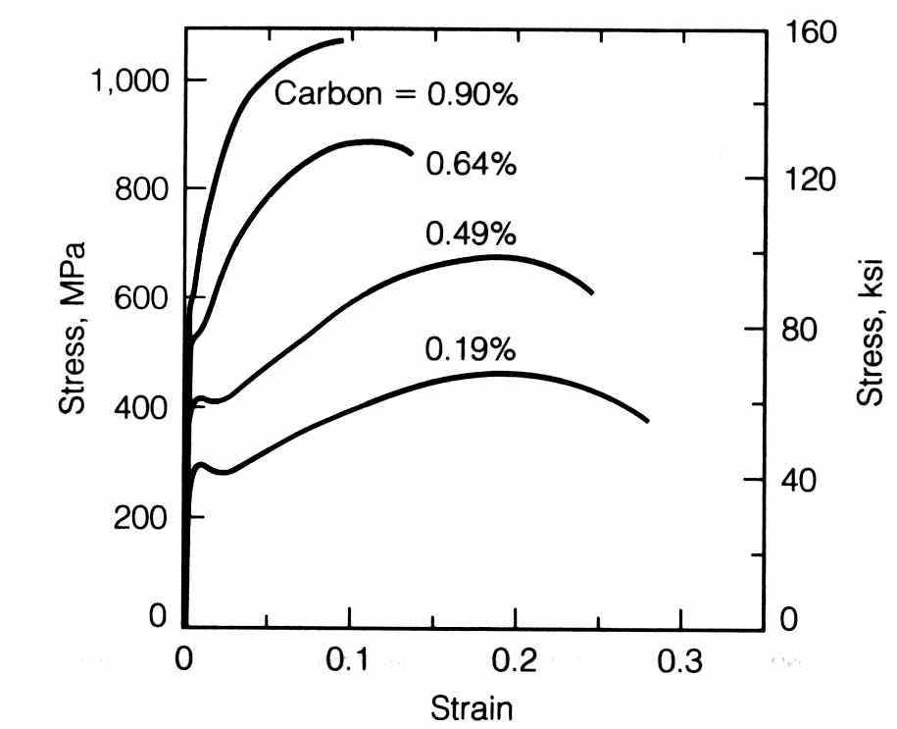
EFFECT OF CARBON ON MECHANICAL BEHAVIOR
Structural Steel 0.12 to 0.30
34

Slide 35
CONSTRUCTION USES OF STEEL
Structural steel → plates, bars, pipes, structural shapes, etc.
Cold formed steel →studs, trusts, roofing, cladding
Fastening products → bolts, nuts, washers
Reinforcing steel → rebar for concrete
Miscellaneous → forms, pans, hardware, etc.
35

Slide 36
ALUMINUM
Primarily used for containers, packaging, aircrafts, and automobiles.
In civil projects, primarily used for architectural and finishing elements like doors, windows, and siding with a small amount used for electrical wiring.
Not used extensively for structural members:
expense
strength and ductility
coefficient of thermal expansion
36

Slide 37
ALUMINUM ADVANTAGES
Easy to recycle
Corrodes slightly but does not rust
High reflectivity
Can be die cast
Easily machined
Nonmagnetic
Nontoxic
Most plentiful metal on earth
One-third the density of steel
High strength-to-weight ratio
Good thermal and electrical conductivity
Anodizing or hard coating for protection
Weldable alloys
37

